Slide 1
Deep Learning for Arbitrary Stock Forecasting
Presented by: Abdul Wahid
Stundent ID: aw22694

Slide 2
Stock Market

Slide 3
Stock Market
The stock market is a financial marketplace where individuals and institutions buy and sell ownership stokes publicly traded companies.
Investors trade stocks in the stock market to potentially earn capital gains and dividends, with prices influenced by supply and demand dynamics and company performance.

Slide 4
Primary vs Secondary
Primary Market:
Initial issuance of new shares by companies to raise capital for various purposes.
Newly issued securities are offered to the public for the first time, allowing companies to raise capital directly from investors.
Secondary Market:
Trading of existing shares among investors, providing liquidity and facilitating buying and selling.
It facilitates the trading of existing securities among investors, providing liquidity and enabling price discovery based on supply and demand dynamics.

Slide 5
Time Series Forecasting

Slide 6
Time Series Forecasting
Common method used for Stock Market prediction
Time series forecasting models can be divided into two main types:
• Liner Models
• Non-Linear Models

Slide 7
Linear Model
Assume a linear relationship between historical data and the target variable.
Simpler and easier to interpret, making them suitable for basic forecasting tasks.
Work well when data exhibits a linear trend or when seasonal patterns are adequately captured by their components.
Common linear models include AR, MA, ARMA, and ARIMA.
May struggle to capture complex and non-linear patterns in the data.
Assume a straightforward relationship between past data and future predictions, which may not reflect the true underlying behavior of the time series.

Slide 8
Non-Linear model
Do not assume a linear relationship between historical data and the target variable.
Can capture more complex patterns and relationships in the data.
Particularly useful when data exhibits non-linear trends or long-term dependencies.
Examples include LSTM, SVM, and Prophet.
Are more flexible and can handle a wider range of data patterns.
Come with some disadvantages, including increased complexity, risk of overfitting, and the need for hyper parameter tuning.

Slide 9
Tools

Slide 10
Tools
IDE – Visual Studio Code
Language – Python
Database – Yahoo Finance

Slide 11
Project Planning

Slide 12
Project planning
Outlining Tasks
Timelines
Dependencies
Collecting Resources
Work Breakdown Structure (WBS)
Project Schedule and Milestones

Slide 13
Literature review

Slide 14
1-Traditional Deep learning models

Slide 15
Recurrent Neural Networks (RNNs)
RNNs maintain a consistent input size and transition from one state to another.
They use an identical transition function with uniform parameters at each time step.

Slide 16
LSTM Architecture
LSTM cells replace conventional hidden layers.
LSTM cells include multiple gates (input gate, cell state, forget gate, and output gate).
Comprises sigmoid and tanh layers and pointwise multiplication operations.

Slide 17
Bidirectional LSTM (BLSTM):
BLSTM models predict data in both future-to-past and past-to-future directions.
Both BLSTM and stacked LSTM networks perform better in short-term price predictions than long-term.
Deep learning methods outperform shallow neural networks.
BLSTM networks excel in short and long-term prediction tasks.

Slide 18
Algorithm Comparisons:
Back Propagation uses NumPy and Pandas libraries for stock price prediction.
LSTM outperforms Back Propagation and SVM for stock market prediction due to its suitability for time series problems.
SVM acts as a non-probabilistic binary classifier, creating gaps between different classifications in the representation space.

Slide 19
Summary
In summary, this information highlights the use of RNNs, particularly LSTM and BLSTM, in stock market prediction, with LSTM being the most effective algorithm for time series forecasting in this context.

Slide 20
2-Comparative Study of Deep Learning Models

Slide 21
Overview of Financial Time Series Forecasting:
Financial time series forecasting has been a focus for machine learning researchers for over four decades.
Recently, deep learning (DL) methodologies have gained attention for predicting financial trends.
This has led to a surge in new publications exploring DL techniques in financial prediction.

Slide 22
Challenges with Machine Learning in Finance:
Machine learning algorithms' performance is highly dependent on data quality.
Stock market time series data resembles a random walk, making feature engineering complex.
Deep learning models have an advantage as they eliminate the need for separate feature engineering.

Slide 23
Comparative Evaluation of RNN Models:
The study compares three recurrent neural network (RNN) models: Vanilla RNN (VRNN), Long Short-Term Memory (LSTM), and Gated Recurrent Unit (GRU).
These RNN variants are renowned for sequence prediction.
The research also examines the optimal look-back period used with RNNs for stock price prediction.
The focus is on two prominent banking stocks: Nepal Investment Bank (NIB) and Nabil Bank Limited (NABIL), enhancing the empirical basis of the study.

Slide 24
summary
In summary, this survey discusses the resurgence of interest in financial time series forecasting, particularly with deep learning methods. It highlights the challenges in applying machine learning to stock market data and presents a comparative evaluation of RNN models and look-back periods for stock price prediction using real banking stocks.

Slide 25
3-Sentiment-Enhanced Models for Stock Trend Prediction

Slide 26
Introduction of TGRU and Stock2Vec
Minh et al. introduced a novel approach involving a two-stream Gated Recurrent Unit (TGRU) network.
They also used a sentiment-enhanced word embedding model called Stock2Vec.
Their goal was short-term stock trend prediction.
Findings demonstrated that the TGRU model outperformed conventional Gated Recurrent Unit (GRU) and Long Short-Term Memory (LSTM) architectures.

Slide 27
Deep Learning Model Capabilities:
Deep learning models, particularly LSTM, excel at extracting intricate temporal patterns from time series data.
Unlike traditional machine learning models that rely on hand-engineered features, deep learning models autonomously uncover complex temporal dependencies.
The investigation showed that LSTM-based deep learning models consistently outperformed conventional machine learning models.
Deep learning models exhibited exceptional prowess in discerning and internalizing intrinsic characteristics within time series data.
Rigorous experiments systematically validated their superior predictive capabilities.

Slide 28
summary
In summary, the study highlights the success of deep learning models, particularly LSTM-based models, in capturing complex temporal patterns in time series data for stock price prediction, surpassing the performance of traditional machine learning models.

Slide 29
4-Deep Learning Models for Cross-Market Stock Price Prediction

Slide 30
Model Performance
Four types of deep neural networks were employed in the analysis: MLP, RNN, LSTM, and CNN models.
MLP network successfully captured seasonal patterns but faced challenges in capturing patterns between days 1600 and 1900.
RNN model showed promising results and was generally successful in identifying underlying patterns.
LSTM and CNN models encountered difficulties in capturing changes in the system during the period between days 1400 and 1800.

Slide 31
Summary
In summary, the dataset encompasses stock data from different sectors, and four deep neural network models (MLP, RNN, LSTM, CNN) were used for analysis. The MLP model excelled in capturing seasonal patterns, while the RNN model showed promise in identifying underlying patterns. However, the LSTM and CNN models faced challenges during specific time periods.

Slide 32
5-Deep Learning’s Dominance in Financial Time Series Forecasting:

Slide 33
Hiransha et al.'s Stock Price Prediction Study
The study used four deep learning architectures and an AutoRegressive Integrated Moving Average (ARIMA) model.
Models were trained with TATA MOTORS' stock prices from the National Stock Exchange of India (NSE) and tested on both NSE and New York Stock Exchange (NYSE) stocks.
Deep learning models, including MLP, RNN, LSTM, and CNN, outperformed ARIMA.
CNN exhibited superior performance among the deep learning architectures.

Slide 34
Deep Learning in Stock Price Prediction:
Deep learning is a prominent subset of machine learning.
It uses neural networks with multiple layers, evolving weights during training to make predictions.
Neural networks autonomously learn and understand patterns from data without explicit definition.
Neural networks consist of interconnected neurons, influenced by weights, biases, and activation functions.
Deep learning excels at handling large input datasets and progressively learns intricate data features, enhancing predictive accuracy.

Slide 35
Prediction Results and Challenges:
Preliminary results achieved around 85% accuracy using deep learning models based on closing price values.
Regression Gradient Boosting Machine (GBM) approach also achieved around 85% accuracy.
Deep learning models demonstrated accuracy levels exceeding 70%.
Ensemble algorithms outperformed alternative predictive techniques.
The stock market's inherent dynamism makes 100% accuracy nearly unattainable.
Margin of error ranged from 0.0% to 13.3% in monthly stock data collection.
Gray relation coefficient was used to evaluate individual company rankings.

Slide 36
Future Directions and Enhancements:
Enhancing data collection methods, especially capturing data fluctuations during trading hours.
Integration of high-frequency trading algorithms to improve prediction accuracy.
Efforts to refine feature extraction techniques for better predictive capabilities.
Considering new elements from data to augment existing technical indices in prediction models.

Slide 37
Summary
In summary, the study by Hiransha et al. explored stock price prediction using deep learning models and compared their performance with an ARIMA model. Deep learning models showed promise in achieving high accuracy, especially CNN, and future research directions include data augmentation and feature refinement for improved predictions. Additionally, integrating new data elements with existing indices is considered beneficial for prediction models.

Slide 38
Methodology

Slide 39
1-AutoRegressive Integrated Moving Average (ARIMA)

Slide 40
AutoRegressive Integrated Moving Average (ARIMA):
ARIMA is a statistical method for analyzing and forecasting time series data.
It combines three key components: Autoregressive (AR), Differencing to achieve stationarity (I), and Moving Average (MA).
ARIMA models are widely used in various fields, including economics, finance, climate science, and more.
They are effective for analyzing historical trends, identifying patterns, and making predictions about future values in time series data.

Slide 41
ARIMA Parameters:
p (Autoregressive Order):
  p determines the number of autoregressive (AR) orders in the model.
  It represents the number of past observations used to predict future values.
  A higher p value indicates a model that relies on a longer history of past observations.
d (Differencing Order):
  d determines the order of differencing required to make the time series stationary.
  Stationarity means that the statistical properties of the time series, such as mean and variance, do not change over time.
  Differencing involves subtracting the current value from a lagged value to remove trends or seasonality.
q (Moving Average Order):
  q determines the number of moving average (MA) orders in the model.
  It represents the number of past forecast errors used to predict future values.
  A higher q value indicates a model that considers a longer history of past forecast errors.

Slide 42
Summary
In summary, the ARIMA model is a valuable tool for time series analysis and forecasting, with its key parameters p, d, and q allowing for customization based on the characteristics of the data being analyzed.

Slide 43
2-Convolutional Neural Network (CNN)

Slide 44
Convolutional Neural Network (CNN):
CNNs are versatile tools designed for image analysis but now applied to various data types, including stock market data.
They excel at detecting hidden patterns in time-series data, which is valuable for forecasting financial trends.
CNNs autonomously learn from messy data and uncover tiny trends over time.
They employ unique layers to discover connections between data points and identify important features.

Slide 45
CNN Layers:
Convolutional Layer:
  Responsible for scanning input data and identifying crucial features.
  Performs convolution operations to highlight important aspects in the data.
  Uses a filter (kernel), bias, and activation function to generate output feature maps.
Pooling Layer:
  Summarizes and condenses information from previous layers.
  Helps understand main trends and patterns by applying pooling functions to a window of values in feature maps.
Fully Connected Layer:
  Connects information gathered from previous layers.
  Combines puzzle pieces to create a complete picture.
  Involves a weight matrix, bias, and activation function to generate the output.

Slide 46
Summary
In summary, CNNs are powerful tools for analyzing and forecasting stock market patterns. They consist of convolutional, pooling, and fully connected layers, each with a specific role in processing data and identifying important features for prediction.

Slide 47
3-Recurrent Neural Network (RNN)

Slide 48
Recurrent Neural Network (RNN):
RNN operates by looping back to the input after storing the output from a particular layer.
This looping process allows the model to predict the subsequent output from that layer.
RNNs are characterized by their hidden state, often called the Memory State, which stores important details about earlier sequences.
They use uniform parameters across all inputs, reducing parameter complexity compared to other neural networks.

Slide 49
RNN
RNN Process:
  RNN's current state (h(t)) is determined based on the previous state (h(t−1)) and the input state (x(t)).
  The function f represents the operations performed on these inputs and hidden layers to generate outputs.
Challenges of RNN:
  RNNs are suitable for managing sequential data but have limitations.
  They struggle with learning and retaining long-range dependencies in sequences due to vanishing and exploding gradient problems.

Slide 50
Summary
In summary, RNNs are designed to work with sequential data by looping back and using a hidden state to store important information about earlier sequences. However, they face challenges in handling long-range dependencies.

Slide 51
4-PROPHET

Slide 52
PROPHET:
PROPHET is an additive model used for time series forecasting.
It decomposes time series data into components like trend, seasonality, holiday impacts, and unexpected changes.
Known for its simplicity and ease of use, PROPHET can capture diverse patterns in data without extensive hyper parameter tuning.
It's particularly useful for creating short- to medium-term forecasts for time series data.
Developed by Facebook's Core Data Science team, PROPHET is widely used in time series analysis and forecasting.

Slide 53
Prophet:
PROPHET Process:
  The PROPHET model is represented by the equation: y(t) = g(t) + s(t) + h(t) + e(t)
  Components:
    g(t) represents non-periodic trend changes.
    s(t) captures periodic seasonality changes.
    h(t) accounts for holiday effects.
    e(t) covers unexpected changes that the model does not account for.
PROPHET's Importance:
  PROPHET may lack the complexity of deep learning models but remains a valuable tool for data analysts and forecasters.
  It is particularly effective for handling time series data with strong patterns and repeating events.

Slide 54
summary
In summary, PROPHET is a widely used forecasting tool known for its simplicity and effectiveness in capturing various patterns in time series data. It decomposes data into key components, making it a valuable asset for data analysts and forecasters dealing with specific types of time series data.

Slide 55
5-Long Short-Term Memory (LSTM)

Slide 56
Long Short-Term Memory (LSTM):
LSTM is a type of recurrent neural network (RNN) architecture designed to address the vanishing gradient problem and capture long-term dependencies.
It is highly suitable for sequence data, including time series, natural language, and voice.
LSTM incorporates three gates (forget gate, input gate, output gate) that control information flow, allowing selective retention or deletion of data at each time step.
This gating mechanism balances short-term and long-term memory while effectively handling gradient vanishing issues.
LSTMs find applications in various fields, such as natural language processing, time series forecasting, and anomaly detection.
Despite their capabilities, LSTMs require careful hyperparameter tuning and may face challenges with extremely long sequences or complex patterns.

Slide 57
Lstm:
LSTM Formula:
  The LSTM formula involves gates represented by symbols like it (input gate), ft (forget gate), ot (output gate), sigmoid functions (σ), weights (wx), previous LSTM block output (ht−1), current input (xt), and biases (bx).
Implementation and Tools:
  For stock price prediction, the Yahoo Finance dataset, specifically Apple Company's financial data, was used.
  The dataset contains a wide range of financial variables, including opening and closing prices, daily high and low prices, and trading volume.
  TensorFlow, an open-source machine learning framework known for its numerical computation capabilities, was used.
  Keras, a high-level API for neural networks, smoothly integrates with TensorFlow for efficient experimentation.

Slide 58
Summary
In summary, LSTM is a powerful architecture for handling sequential data, addressing challenges like vanishing gradients and capturing long-term dependencies. It has practical applications in various domains, and in this case, it was implemented using TensorFlow and Keras for stock price prediction using the Yahoo Finance dataset.

Slide 59
Experimental Results and analysis

Slide 60
Mean Squared Error (MSE):
MSE is a measurement that quantifies the average of squared differences between predicted and actual values within a dataset.
A lower MSE indicates that a model's predictions align better with the dataset.
MSE is commonly used as a loss function in regression tasks.
MSE Formula:
The MSE formula calculates the squared differences between predicted (ŷi) and observed (yi) values for each observation and then computes their average over the sample size (n).

Slide 61
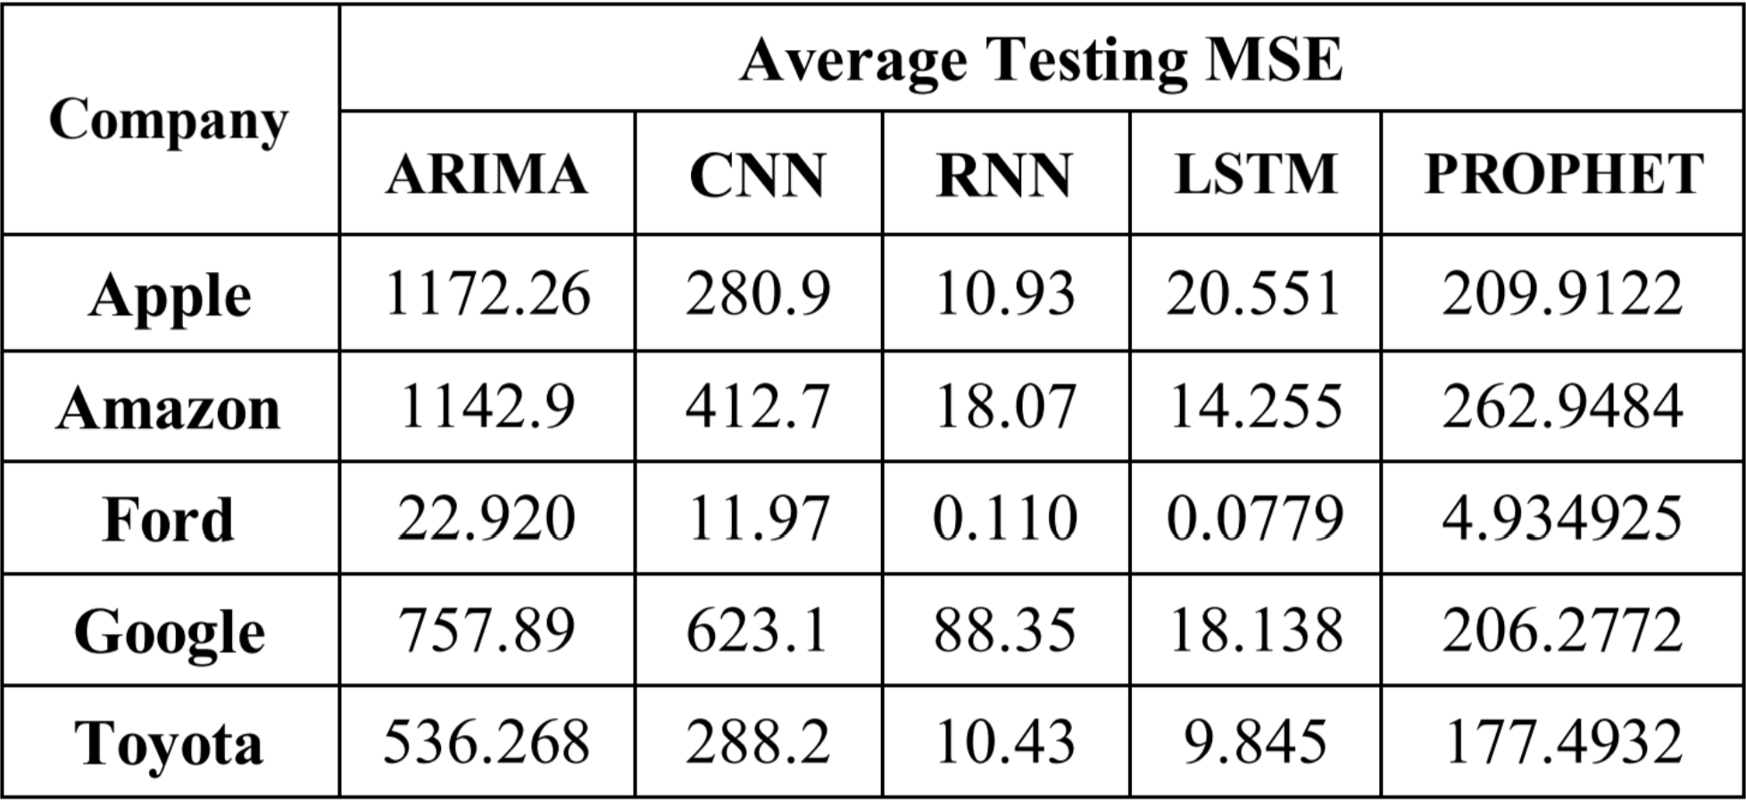
Results mse:

Slide 62
Root Mean Squared Error (RMSE):
RMSE is a measurement that provides the square root of the mean squared difference between predicted and actual values within a dataset.
A lower RMSE signifies that a model's predictions are more closely aligned with the dataset.
RMSE is a useful metric for assessing the accuracy of predictions, and it has the same units as the original data.
RMSE Formula:
The RMSE formula calculates the square root of the mean squared differences between predicted (ŷi) and observed (yi) values for each observation, averaged over the sample size (n).

Slide 63
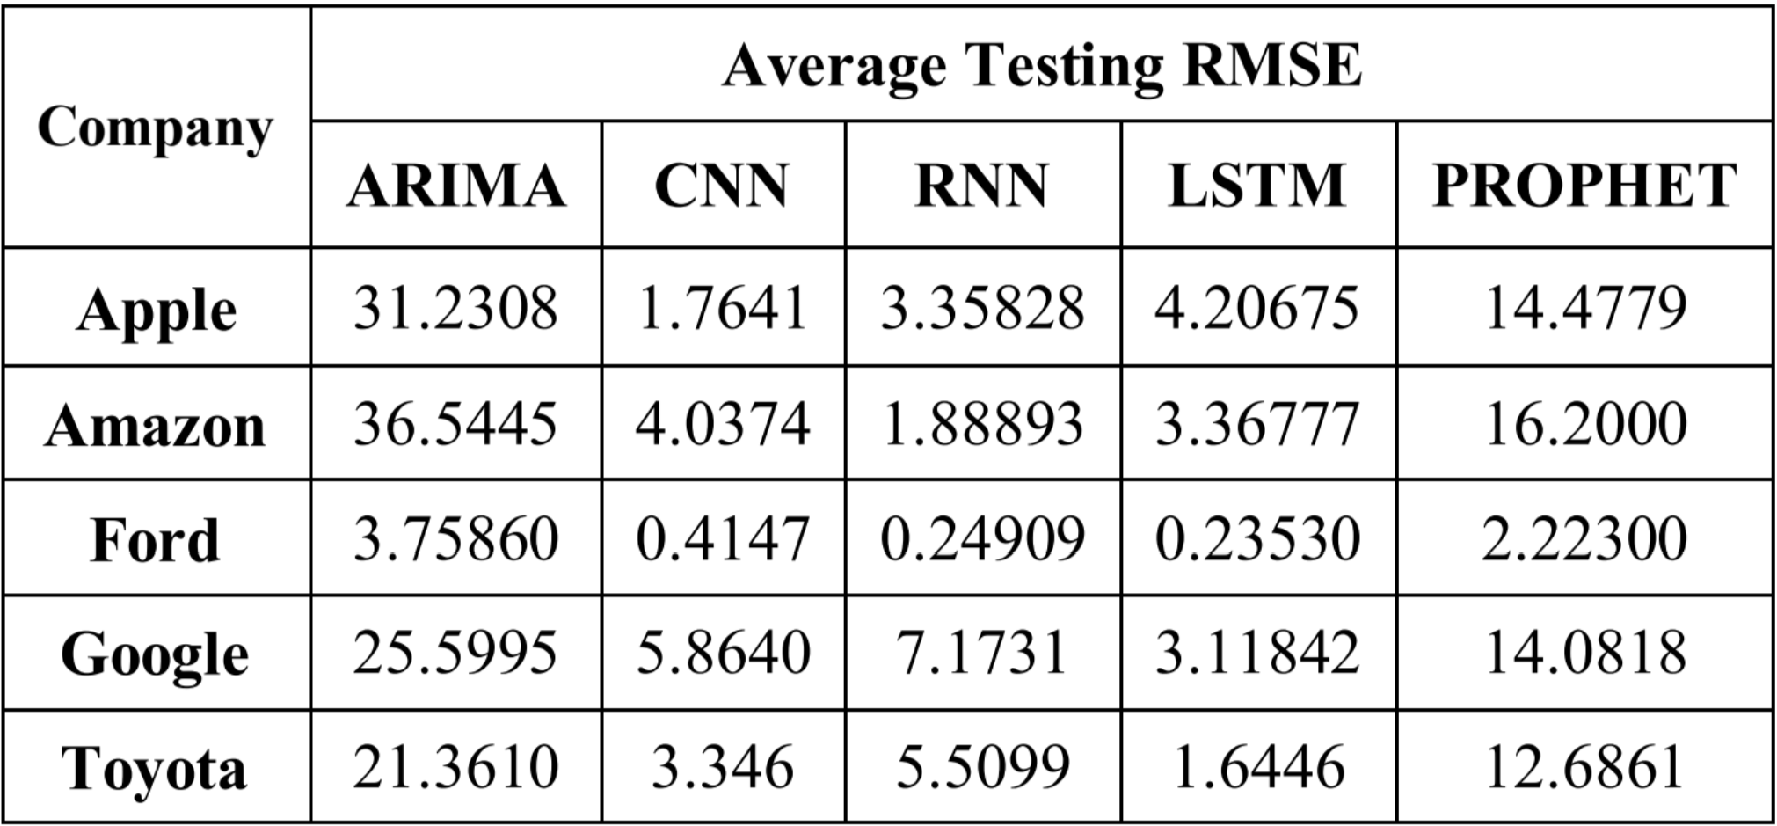
Results rmse:

Slide 64
Summary
In summary, MSE and RMSE are common metrics for evaluating the performance of predictive models by measuring the differences between predicted and actual values in a dataset. Lower values of MSE and RMSE indicate better model alignment with the data.

Slide 65
Conclusion and Future Scope

Slide 66
Summary of Research:
This paper explores various methodologies for predicting stock index values and movement trends using deep learning models: ARIMA, CNN, RNN, LSTM, and PROPHET, applied to the Yahoo Finance dataset.
Stock market prediction is a complex task, with technical analysis relying on statistical insights from market activities.
The choice of the most suitable model among CNN, RNN, LSTM, ARIMA, and PROPHET depends on various factors, with each model having distinct advantages and drawbacks.
LSTM stands out among deep learning models, particularly due to its unique architecture, which addresses the limitations of traditional RNNs.
LSTMs excel in managing long-term dependencies in sequential data, overcoming the vanishing gradient problem, and effectively capturing complex temporal patterns.

Slide 67
Research Findings:
LSTMs are effective in managing long-term dependencies and offer a potential approach for accurately capturing complex temporal patterns, making them suitable for stock price prediction.
Deep learning models outperform their machine learning counterparts in comprehending and capturing time series data attributes.

Slide 68
Future Scope:
The research opens up several avenues for future exploration:
Further fine-tuning and optimization of deep learning models to improve stock price prediction accuracy.
Investigation into ensemble methods and hybrid models that combine the strengths of multiple predictive techniques.
Exploration of additional data sources and features that can enhance the accuracy of stock market predictions.
Application of deep learning models to other financial prediction tasks, such as volatility forecasting or portfolio optimization.
Continuous monitoring of evolving deep learning techniques and their applicability to stock market prediction.

Slide 69
Conclusion
In conclusion, this research highlights the effectiveness of deep learning models, especially LSTM, in capturing complex temporal patterns and improving stock price prediction. The study provides a foundation for future research in the field of financial forecasting and opens up opportunities for further enhancements in predictive accuracy and model development.

